Slide 1

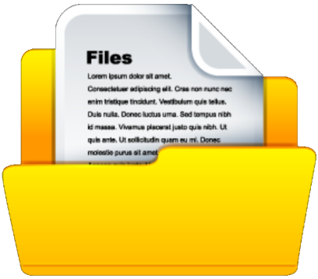

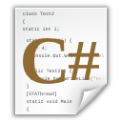
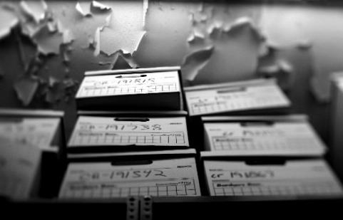

Text Files
http://csharpfundamentals.telerik.com
Reading and Writing Text Files
Svetlin Nakov
Technical Trainer
www.nakov.com
Telerik Software Academy
academy.telerik.com

Slide 2


Table of Contents
What is Stream?
Stream Basics
Reading Text Files
The StreamReader Class
Writing Text Files
The StreamWriter Class
Handling I/O Exceptions

Slide 3

What Is Stream?
Streams Basic Concepts

Slide 4



What is Stream?
Stream is the natural way to transfer data in the computer world
To read or write a file, we open a stream connected to the file and access the data through the stream
Input stream
Output stream

Slide 5
Streams Basics
Streams are used for reading and writing data into and from devices
Streams are ordered sequences of bytes
Provide consecutive access to its elements
Different types of streams are available to access different data sources:
File access, network access, memory streams and others
Streams are open before using them and closed after use

Slide 6
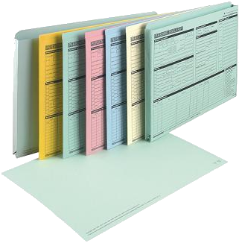
Reading Text Files
Using the StreamReader Class

Slide 7
The StreamReader Class
System.IO.StreamReader
The easiest way to read a text file
Implements methods for reading text lines and sequences of characters
Constructed by file name or other stream
Can specify the text encoding (for Cyrillic use windows-1251)
Works like Console.Read() / ReadLine() but over text files

Slide 8
StreamReader Methods
new StreamReader(fileName)
Constructor for creating reader from given file
ReadLine()
Reads a single text line from the stream
Returns null when end-of-file is reached
ReadToEnd()
Reads all the text until the end of the stream
Close()
Closes the stream reader

Slide 9
Reading a Text File
Reading a text file and printing its content to the console:
Specifying the text encoding:
StreamReader reader = new StreamReader("test.txt");
string fileContents = reader.ReadToEnd();
Console.WriteLine(fileContents);
streamReader.Close();
StreamReader reader = new StreamReader(
"cyr.txt", Encoding.GetEncoding("windows-1251"));
// Read the file contents here ...
reader.Close();

Slide 10
Using StreamReader – Practices
The StreamReader instances should always be closed by calling the Close() method
Otherwise system resources can be lost
In C# the preferable way to close streams and readers is by the "using" construction
It automatically calls the Close()after the using construction is completed
using (<stream object>)
{
// Use the stream here. It will be closed at the end
}

Slide 11

Reading a Text File – Example
Read and display a text file line by line:
StreamReader reader =
new StreamReader("somefile.txt");
using (reader)
{
int lineNumber = 0;
string line = reader.ReadLine();
while (line != null)
{
lineNumber++;
Console.WriteLine("Line {0}: {1}",
lineNumber, line);
line = reader.ReadLine();
}
}

Slide 12
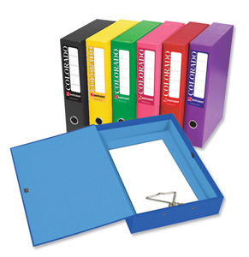
Reading Text Files
Live Demo

Slide 13

Writing Text Files
Using the StreamWriter Class

Slide 14
The StreamWriter Class
System.IO.StreamWriter
Similar to StreamReader, but instead of reading, it provides writing functionality
Constructed by file name or other stream
Can define encoding
For Cyrillic use "windows-1251"
StreamWriter streamWriter =
new StreamWriter("test.txt");
StreamWriter streamWriter =
new StreamWriter("test.txt",
false, Encoding.GetEncoding("windows-1251"));

Slide 15
StreamWriter Methods
Write()
Writes string or other object to the stream
Like Console.Write()
WriteLine()
Like Console.WriteLine()
Flush()
Flushes the internal buffers to the hard drive
AutoFlush
Flush the internal buffer after each writing

Slide 16

Writing to a Text File – Example
Create text file named "numbers.txt" and print in it the numbers from 1 to 20 (one per line):
StreamWriter streamWriter =
new StreamWriter("numbers.txt");
using (streamWriter)
{
for (int number = 1; number <= 20; number++)
{
streamWriter.WriteLine(number);
}
}

Slide 17

Writing Text Files
Live Demo

Slide 18

Handling I/O Exceptions
Introduction

Slide 19
What is Exception?
"An event that occurs during the execution of the program that disrupts the normal flow of instructions“ – definition by Google
Occurs when an operation can not be completed
Exceptions tell that something unusual has happened, e. g. error or unexpected event
I/O operations throw exceptions when operation cannot be performed (e.g. missing file)
When an exception is thrown, all operations after it are not processed

Slide 20

How to Handle Exceptions?
Using try{}, catch{} and finally{} blocks:
try
{
// Some exception is thrown here }
catch (<exception type>)
{ // Exception is handled here
}
finally
{
// The code here is always executed, no
// matter if an exception has occurred or not }

Slide 21
Catching Exceptions
Catch block specifies the type of exceptions that is caught
If catch doesn’t specify its type, it catches all types of exceptions
try
{
StreamReader reader = new StreamReader("file.txt");
Console.WriteLine("File successfully open.");
}
catch (FileNotFoundException)
{
Console.Error.WriteLine(
"Can not find 'somefile.txt'.");
}

Slide 22
Handling Exceptions When Opening a File
try
{
StreamReader streamReader = new StreamReader(
"c:\\NotExistingFileName.txt");
}
catch (System.NullReferenceException exc)
{
Console.WriteLine(exc.Message);
}
catch (System.IO.FileNotFoundException exc)
{
Console.WriteLine(
"File {0} is not found!", exc.FileName);
}
catch
{
Console.WriteLine("Fatal error occurred.");
}

Slide 23

Handling I/O Exceptions
Live Demo

Slide 24
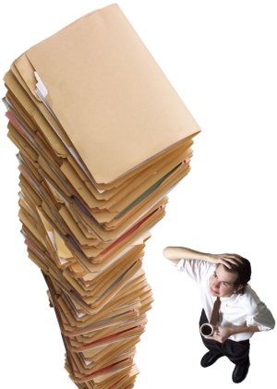
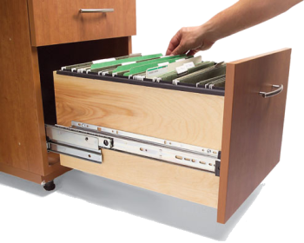
Reading and Writing Text Files
More Examples

Slide 25
Counting Word Occurrences – Example
Counting the number of occurrences of the word "foundme" in a text file:
StreamReader streamReader =
new StreamReader(@"..\..\somefile.txt");
int count = 0;
string text = streamReader.ReadToEnd();
int index = text.IndexOf("foundme", 0);
while (index != -1)
{
count++;
index = text.IndexOf("foundme", index + 1);
}
Console.WriteLine(count);
What is missing in this code?
Notes:
The missing code is the "using" block. The file should be properly closed.

Slide 26
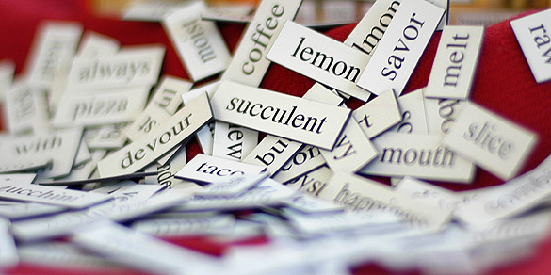
Counting Word Occurrences
Live Demo

Slide 27
Reading Subtitles – Example
We are given a standard movie subtitles file:
.....
{2757}{2803} Allen, Bomb Squad, Special Services...
{2804}{2874} State Police and the FBI!
{2875}{2963} Lieutenant! I want you to go to St. John's Emergency...
{2964}{3037} in case we got any walk-ins from the street.
{3038}{3094} Kramer, get the city engineer!
{3095}{3142} I gotta find out a damage report. It's very important.
{3171}{3219} Who the hell would want to blow up a department store?
.....

Slide 28
Fixing Subtitles – Example
Read subtitles file and fix it’s timing:
static void Main()
{
try
{
// Obtaining the Cyrillic encoding
System.Text.Encoding encodingCyr =
System.Text.Encoding.GetEncoding(1251);
// Create reader with the Cyrillic encoding
StreamReader streamReader =
new StreamReader("source.sub", encodingCyr);
// Create writer with the Cyrillic encoding
StreamWriter streamWriter =
new StreamWriter("fixed.sub",
false, encodingCyr);
(example continues)

Slide 29
Fixing Subtitles – Example
try
{
string line;
while (
(line = streamReader.ReadLine()) != null)
{
streamWriter.WriteLine(FixLine(line));
}
}
finally
{
streamReader.Close();
streamWriter.Close();
}
}
catch (System.Exception exc)
{
Console.WriteLine(exc.Message);
}
}
FixLine(line) perform fixes on the time offsets:
multiplication or/and addition with constant

Slide 30

Fixing Movie Subtitles
Live Demo

Slide 31
Summary
Streams are the main I/O mechanisms in .NET
The StreamReader class and ReadLine() method are used to read text files
The StreamWriter class and WriteLine() method are used to write text files
Always put file handling in using(…) block
Exceptions are unusual events or error conditions
Can be handled by try-catch-finally blocks

Slide 32

Text Files
http://csharpfundamentals.telerik.com

Slide 33
Övningar
När man jobbar med text och filer så används ofta Reguljära Uttryck ( Regular Expressions)
Läs mer om Regex på https://docs.microsoft.com/en-us/dotnet/standard/base-types/regular-expressions

Slide 34
Exercises
Write a program that reads a text file and prints on the console its odd lines.
Write a program that concatenates two text files into another text file.
Write a program that reads a text file and inserts line numbers in front of each of its lines. The result should be written to another text file.
Write a program that compares two text files line by line and prints the number of lines that are the same and the number of lines that are different. Assume the files have equal number of lines.

Slide 35
Exercises (2)
Write a program that reads a text file containing a square matrix of numbers and finds in the matrix an area of size 2 x 2 with a maximal sum of its elements. The first line in the input file contains the size of matrix N. Each of the next N lines contain N numbers separated by space. The output should be a single number in a separate text file. Example:
4
2 3 3 4
0 2 3 4 17
3 7 1 2
4 3 3 2

Slide 36
Exercises (3)
Write a program that reads a text file containing a list of strings, sorts them and saves them to another text file. Example:
Ivan George
Peter Ivan
Maria Maria
George Peter
Write a program that replaces all occurrences of the substring "start" with the substring "finish" in a text file. Ensure it will work with large files (e.g. 100 MB).
Modify the solution of the previous problem to replace only whole words (not substrings).

Slide 37
Exercises (4)
Write a program that deletes from given text file all odd lines. The result should be in the same file.
Write a program that extracts from given XML file all the text without the tags. Example:
Write a program that deletes from a text file all words that start with the prefix "test". Words contain only the symbols 0...9, a...z, A…Z, _.
<?xml version="1.0"><student><name>Pesho</name> <age>21</age><interests count="3"><interest> Games</instrest><interest>C#</instrest><interest> Java</instrest></interests></student>

Slide 38
Exercises (5)
Write a program that removes from a text file all words listed in given another text file. Handle all possible exceptions in your methods.
Write a program that reads a list of words from a file words.txt and finds how many times each of the words is contained in another file test.txt. The result should be written in the file result.txt and the words should be sorted by the number of their occurrences in descending order. Handle all possible exceptions in your methods.

Slide 39




Free Trainings @ Telerik Academy
“C# Programming @ Telerik Academy
csharpfundamentals.telerik.com
Telerik Software Academy
academy.telerik.com
Telerik Academy @ Facebook
facebook.com/TelerikAcademy
Telerik Software Academy Forums
forums.academy.telerik.com

